Slide 1
Statistics for Soil Survey Part 2
Review of Statistics for Soil Survey Part 1

Slide 2
Part 1 : Topics
The Data That We Use
Data Types
Spatial
Tabular
Sampling Design
Exploratory Data Analysis

Slide 3
The Data That We Use – Data Types
Vectors and Implicit Looping
Dataframes
Factors
Lists
Matrix
Referencing within Objects using [,]
Continuous vs. Discrete

Slide 4
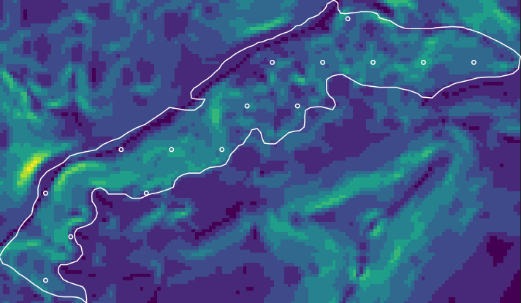
The Data That We Use - Spatial
R packages: sp, raster, rgdal, soilDB, et al.
Data Sources: raster, vector, GPS, fetchNASIS commands
The SP Package: spatial points dataframe
Spatial Reference and Projection with GDAL / OGR
The Raster package: handles common GIS tasks
Import / Export spatial data with R
Exercise: Summarizing PRISM data by MLRA and Soil Series

Slide 5
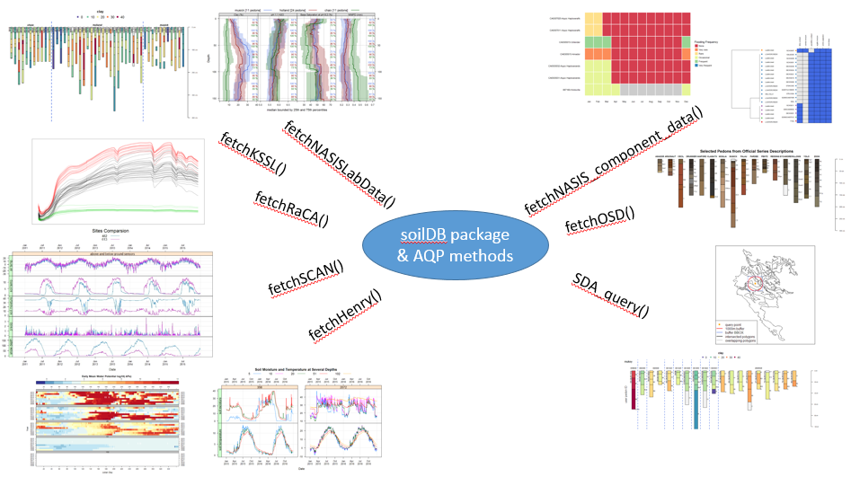
The Data That We Use - Tabular

Slide 6
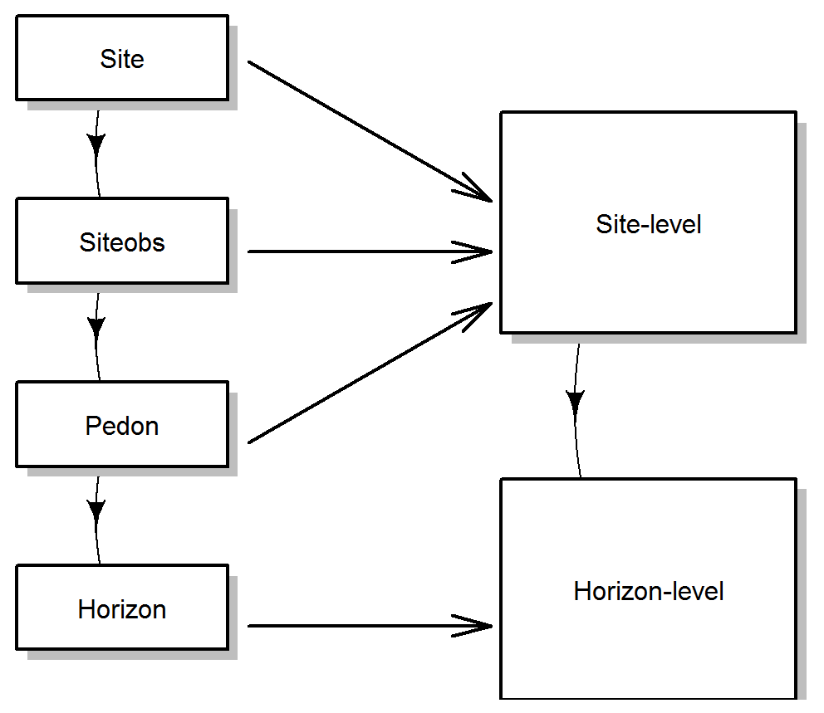
The Data That We Use - Tabular
The AQP and Soil DB packages:
Soil Profile Collections and the fetchNASIS command
Plotting Soil Profile Collections
Plotting Pedon Locations
Regular Expression for pattern matching
Functions
Extended Data Functions
Visualizing Diagnostic Features Example

Slide 7
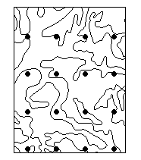
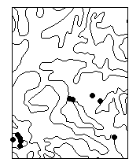
Sampling Design
Sampling Strategies
Simple Random
Stratified Random
Multi-Stage Stratified Random
Systematic
Cluster
Conditioned Latin Hyper-Cube
Evaluation of Sampling Strategies

Slide 8
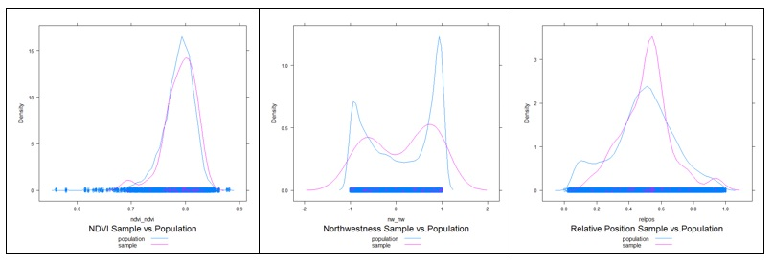
Sampling Design - Evaluation

Slide 9
Exploratory Data Analysis
Data Inspection: descriptive statistics
Examining Distributions: normality, histograms, qq plots
Measure of Central Tendency: mean, median, mode
Measures of Dispersion: variance, standard deviation, box plots
Measures of Association: correlation matrix, scatter plots
Transformations: pH, aspect
The soilReports Package
Zonal Statistics: R, TEUI Toolkit, ArcGIS
Notes:
I’m going to show you 4 graphs

Slide 10
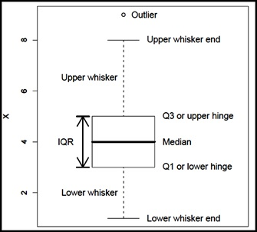
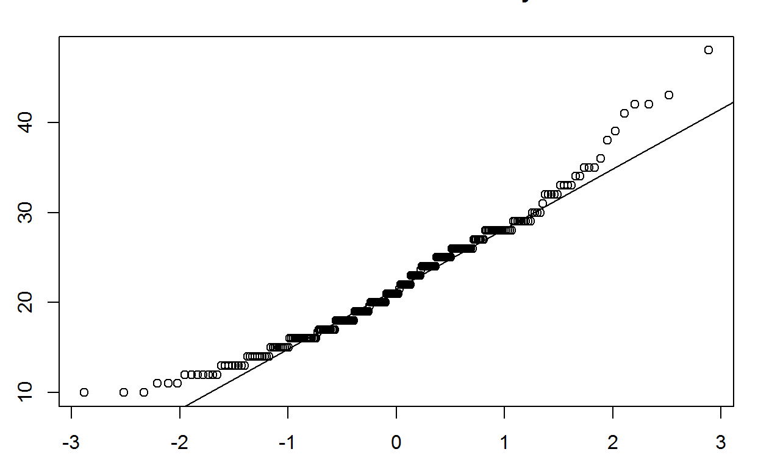
Exploratory Data Analysis
Notes:
Box plot or box and whisker plot on the right – descriptive stats
QQ or quantile-quantile plot ono the left – test for normality

Slide 11
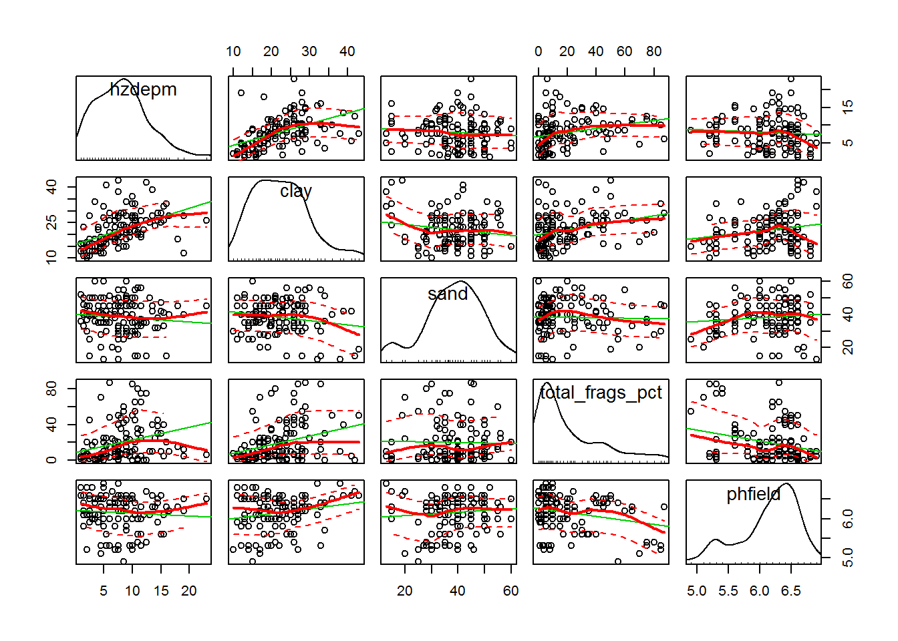
Exploratory Data Analysis
Notes:
Scatter plot matrix – test for association / correlation

Slide 12
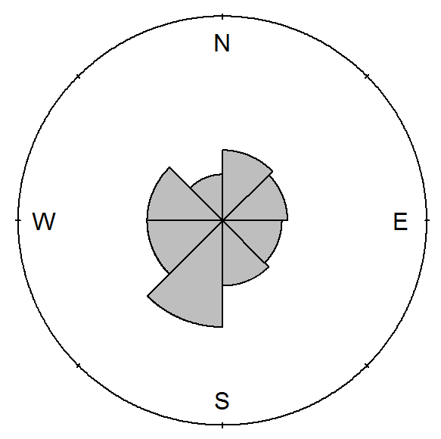
Exploratory Data Analysis
Notes:
Rose diagram for plotting aspect (360 degree or radial data) – transformation to something more useable

Slide 13
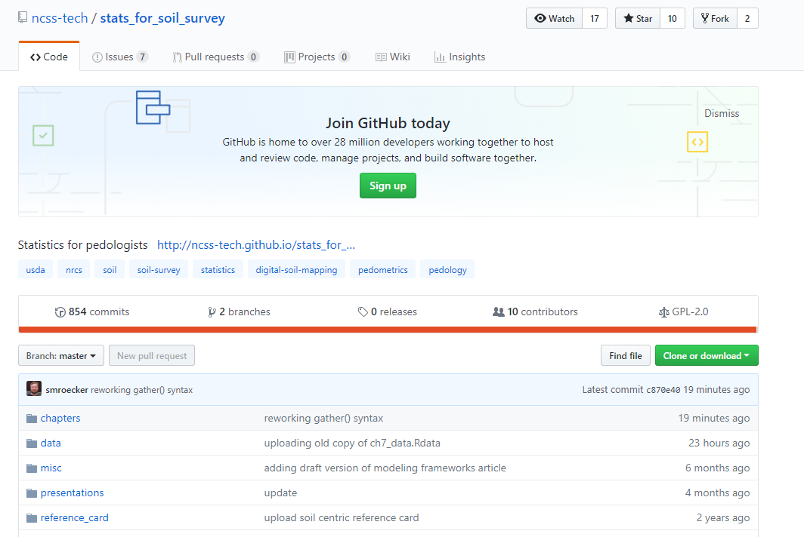

Slide 14
Any Questions ???

Slide 15
Statistics for Soil Survey Part 2
…and now Mr. MichAEl Buffer

Slide 16


